Slide 1
What’s all the fuss about Serverless?
Notes:
Serverless is a buzzword
Show interest and growth in Serverless and share metrics about serverless adoption

Slide 2
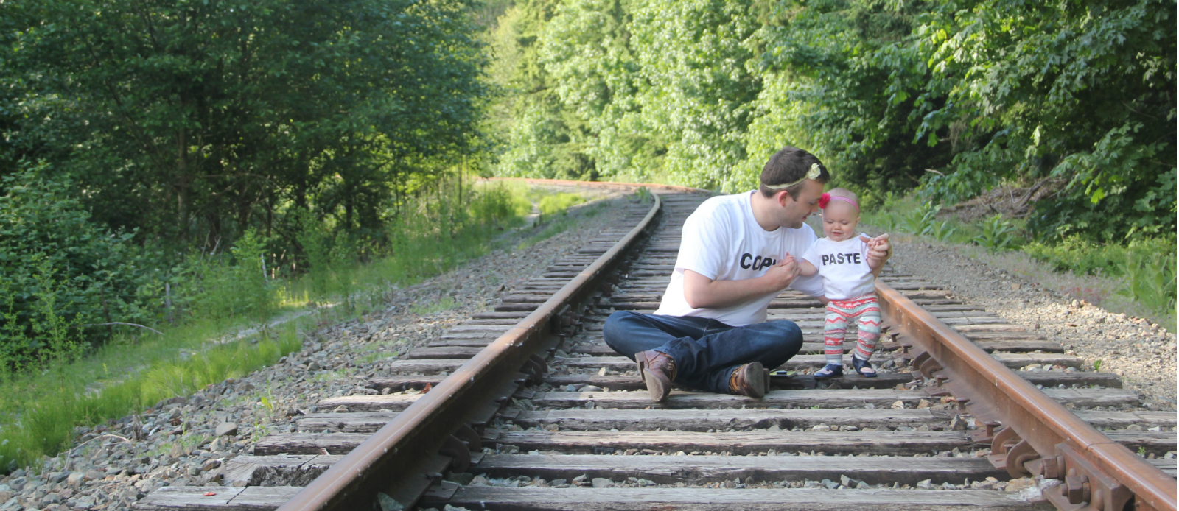
Hello!
Let’s talk about
Serverless
I’m Taylor Krusen
Twitter: @TaylorKrusen

Slide 3

Demo / Adventure
Let’s go to this
10PM
$25
Really darn scary
Please protect me
RSVP
Tweet @TaylorKrusen and include the hashtag #Haunted House
Name / info is added to a sheet in Smartsheet

Slide 4
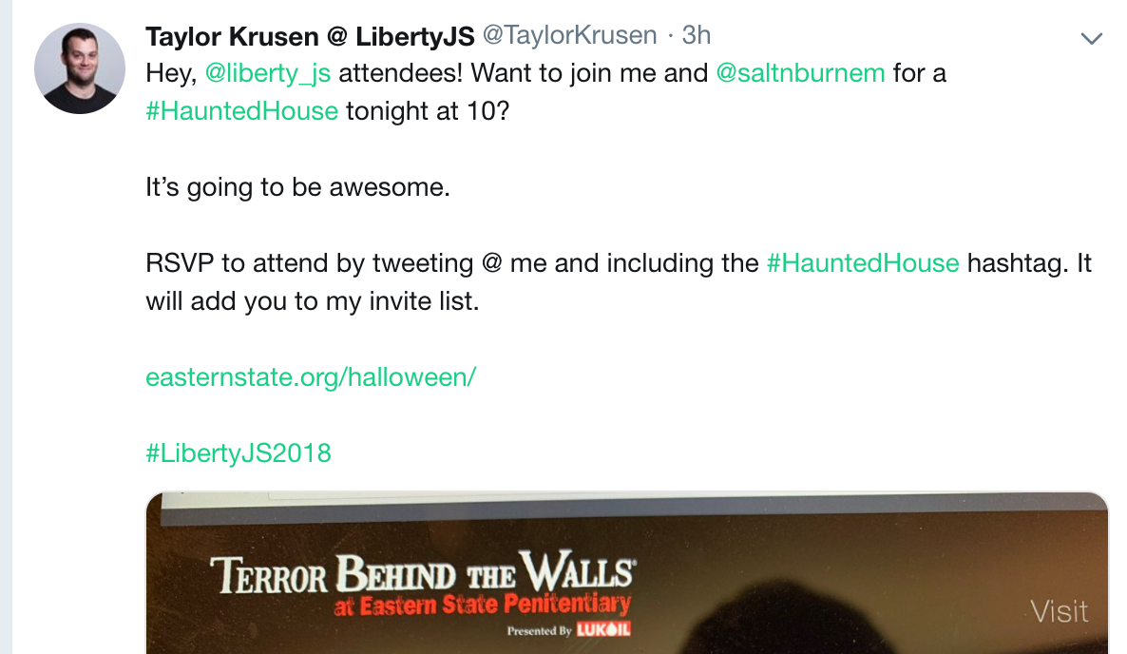
Demo / Adventure
Twitter:
@TaylorKrusen

Slide 5
Overview
What I’ll cover
Serverless as a concept
Reasons for popularity
Pragmatic usage
Goals
Understand serverless and the situations where it will benefit you
Look past marketing jargon
Teach you to navigate the ecosystem of tools
Who is this talk for?
Developers with…
Curiosity / interest in serverless
Limited or no exposure to serverless
Notes:
Give them a chance to leave.
“This is what we’re going to cover”
“This is who its meant for”

Slide 6
Serverless
Notes:
Serverless is a buzzword
Show interest and growth in Serverless and share metrics about serverless adoption

Slide 7
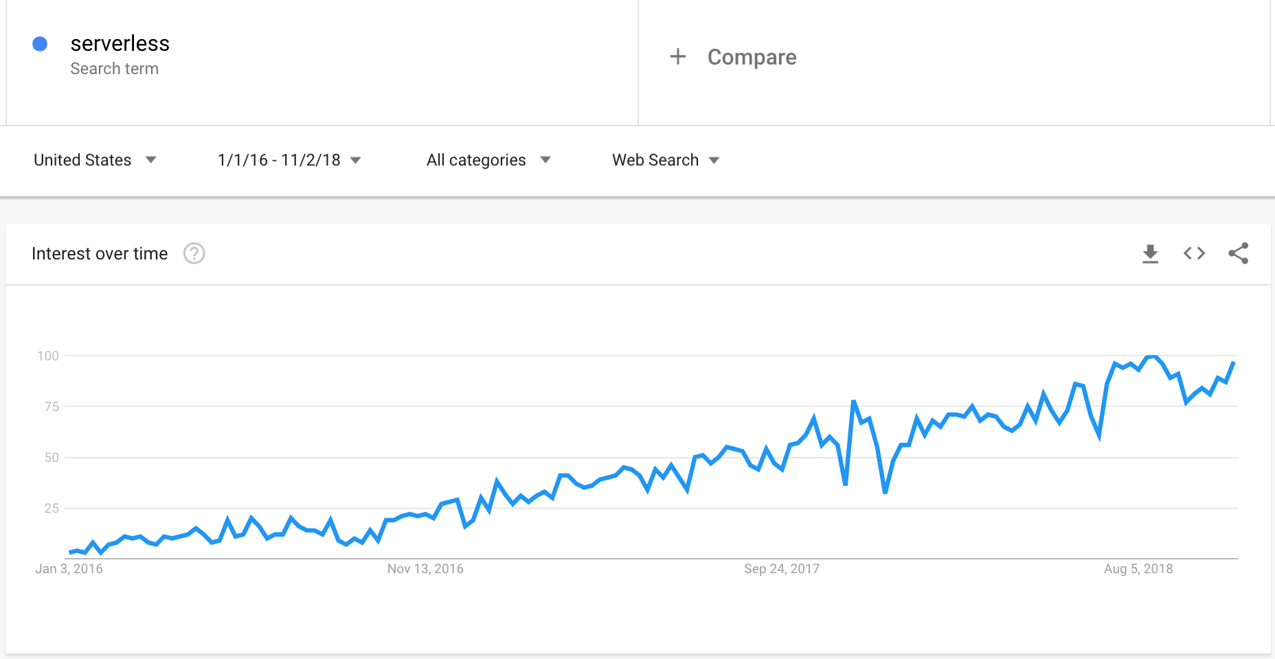
Popularity
Notes:
Who’s here because Buzzword? Yep. Peak interest.
82% metric from serverless survey

Slide 8
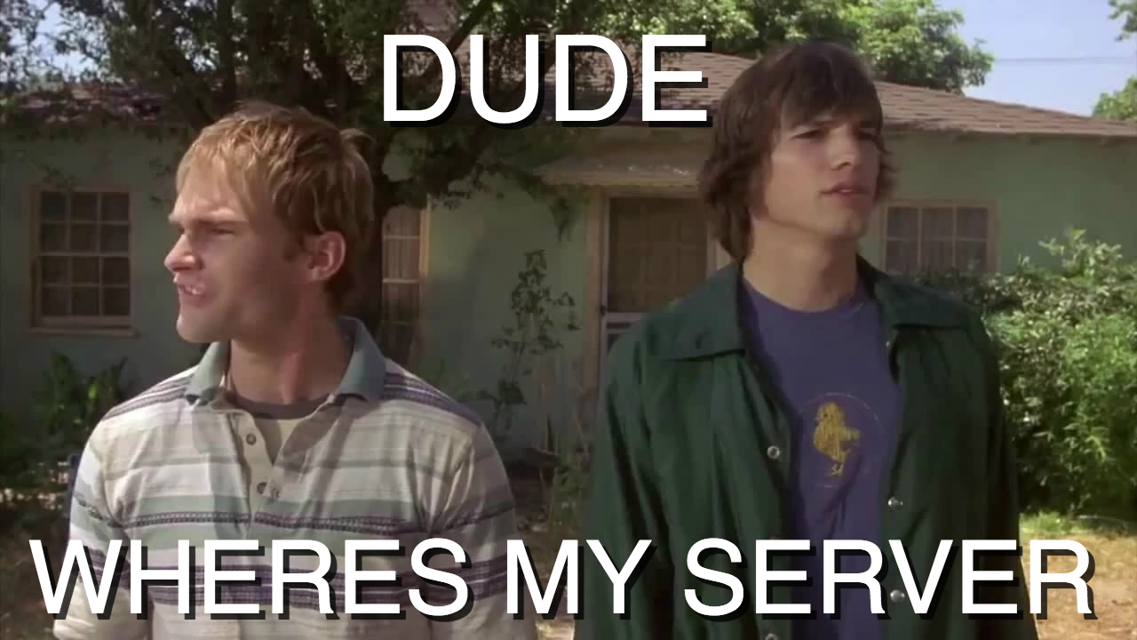
Notes:
people don’t agree on definition
FaaS

Slide 9

Here is my source code,
Run it on the cloud for me,
I do not care how
https://twitter.com/onsijoe/status/598235841635360768

Slide 10
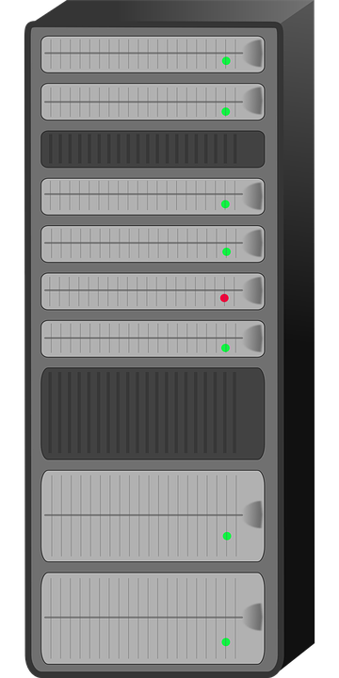

Serverless
Abstraction
Don’t need to own or provision a server.
?
Event-driven
?
Managed FaaS in the cloud.
Pay-per-use
Only charged for code that runs
Notes:
Physical / logistical concerns of server are abstracted away
Define FaaS
“An event driven system that utilizes FaaS and other fully managed services for logic and persistence”.
Spectrum

Slide 11
Serverless Spectrum
Less
Serverless
More
Serverless
Degree of serverlessness
Reliance on BaaS (third-party services)
Ephemeral computing
Degree of ‘control’ over server
Coupling of resources used and resources billed
Notes:
Help distinguish between offerings
Dependence on existing tools. Buy vs build
Ephemeral compute
Resources billed match whats used

Slide 12
“
“Abstraction is selective ignorance”
Andrew Koenig
Notes:
Not an excuse not to understand servers
Important to be pragmatic

Slide 13
Alphabet Soup
Ephemeral
Something short-lived or temporary.
Server
A computer device or program that provides functionality for other programs / devices.
FaaS = Function as a Service
Allows users to develop, run and manage app functionalities without building or maintaining the related infrastructure.
BaaS = Backend as a Service
Middleware that allows developers to connect their app to cloud services.
PaaS = Platform as a Service
Similar to FaaS, but different architecture and scaling.
Long running application thread.
Bill per time running rather than by execution.
IaaS = Infrastructure as a Service
Hardware is provided and managed by an external vendor.
Notes:
TODO: Does this reveal too much info about the terms before the next few slides?

Slide 14
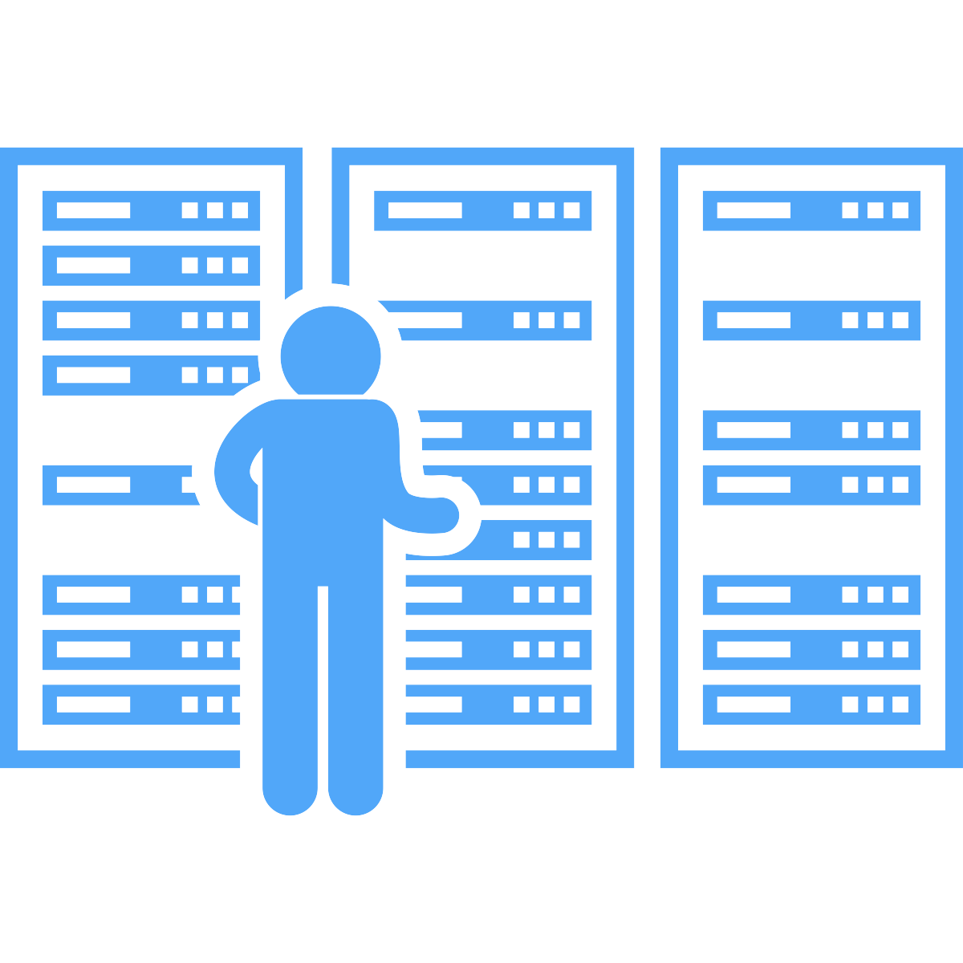
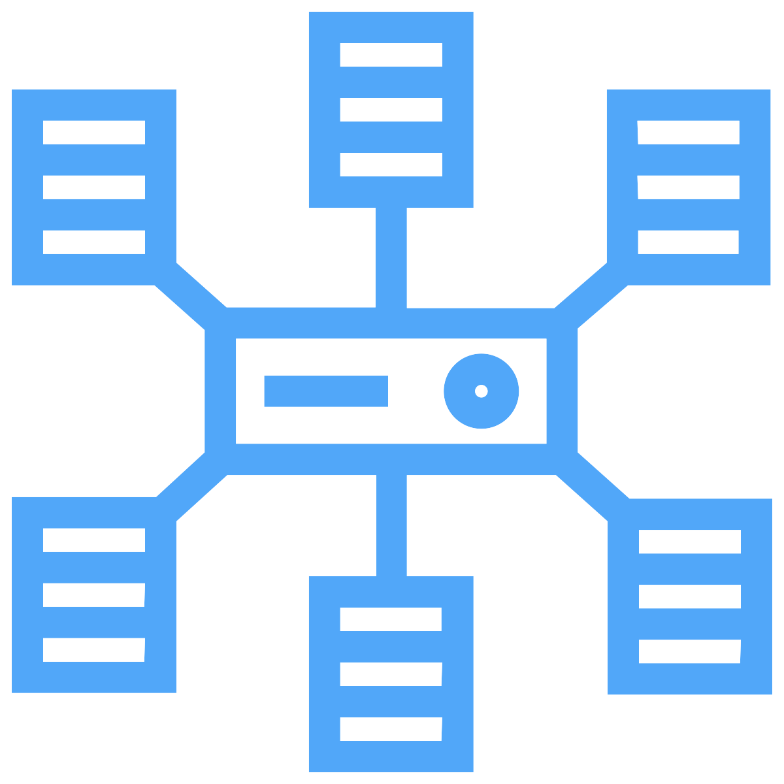
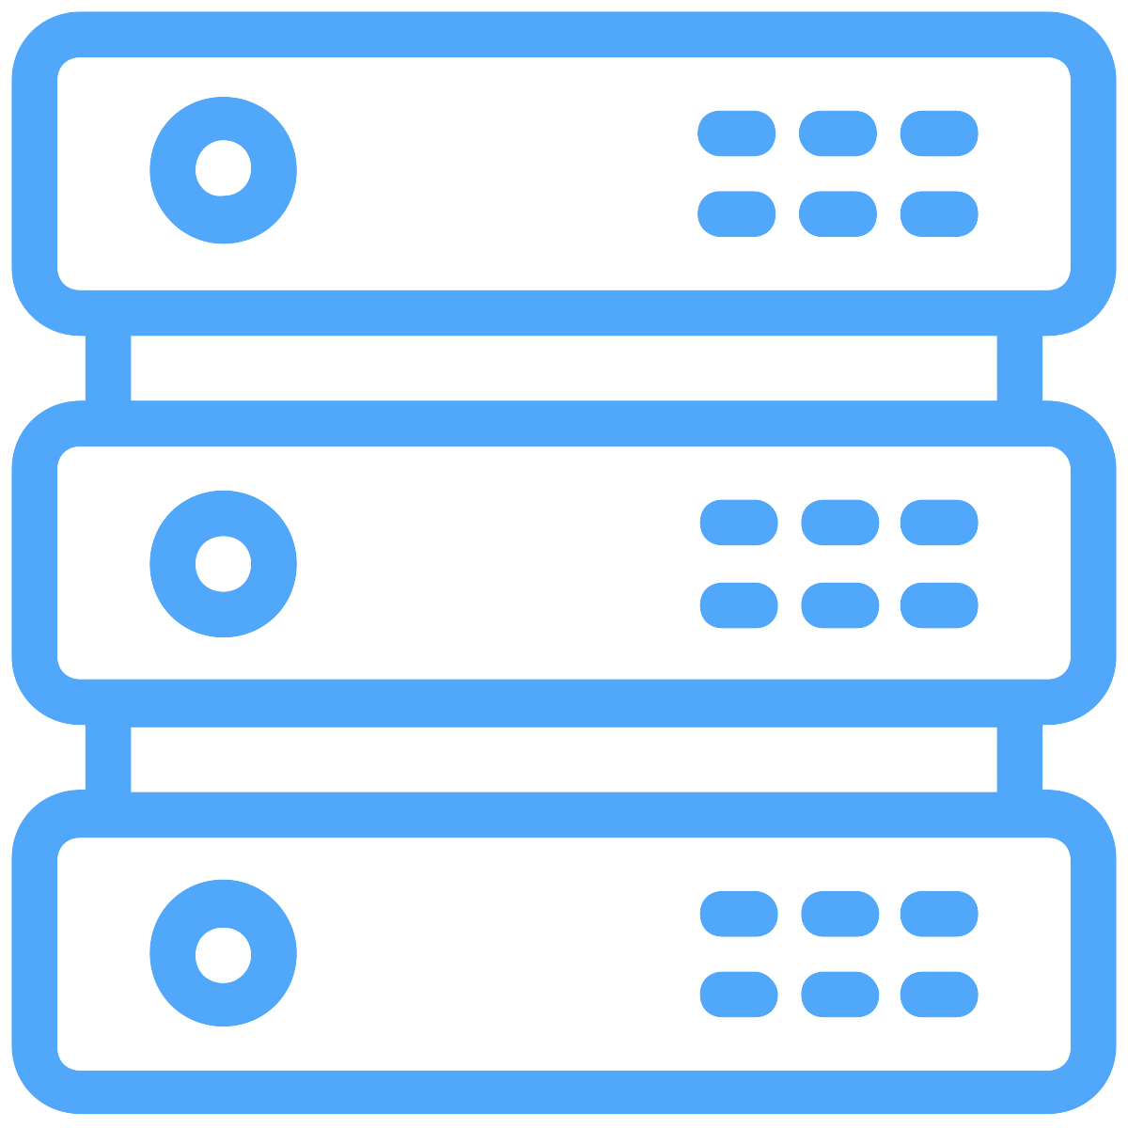


On-Prem
IaaS
PaaS
Serverless

Slide 15
Evolution of Cloud Offerings
On Premise
IaaS
PaaS
Serverless
BaaS
Applications
Data
Runtime
Middleware
O/S
Virtualization
Servers
Storage
Networking
Applications
Data
Runtime
Middleware
O/S
Virtualization
Servers
Storage
Networking
Applications
Data
Runtime
Middleware
O/S
Virtualization
Servers
Storage
Networking
You
Sandbox
Everything else
Buy instead
of Build
You
You
Vendor
You
Vendor
Vendor
Notes:
On premise handled everything.
IaaS = they own hardware. ‘virtualization’
PaaS = heroku, AWS EC2 instance
BaaS = twilio, dynamo db, cosmo db, Auth0
FaaS = sandbox / runtime
Less $$, more abstraction

Slide 16





Backend-as-a-Service
Authentication
BaaS
apps
Search
Client
FaaS
Database
Notes:
TODO: better graphic

Slide 17
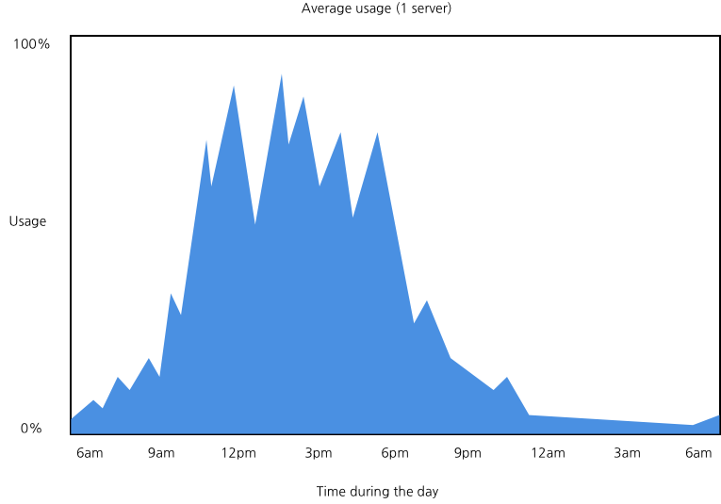

Slide 18
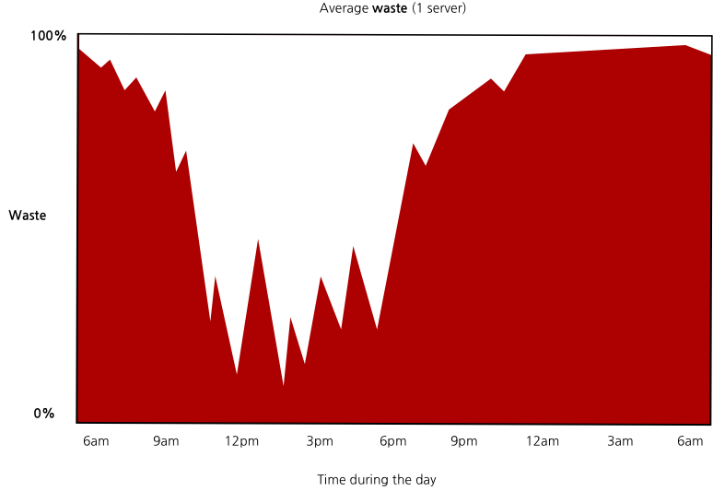

Slide 19


Winners
Startup and small business
Enterprise
Notes:
Who’s here because Buzzword? Yep. Peak interest.
82% metric from serverless survey

Slide 20
Why
Developers can focus on business value
$$
Auto-scaling web apps and APIs
Disruptive pricing model
Usage
Notes:
TODO: Make better graphic…
Economies of Scale
“faster” = provisioning. Able to provision work environments for teams immediately.
“deprovisioning”

Slide 21
Benefits and Compromises
Speed / Velocity / Agility
Stateless
Faster time to market
Less to build
Lack of tooling
Less control
Simplicity
No knobs to tweak
Very easy for users of the FaaS
Architectural complexity
‘mini monoliths’
Someone needs to wrap their head around everything
Notes:
TODO: make this look better.

Slide 22
Benefits and Compromises
Lower operational burden
Implementation drawbacks
Outsourced infrastructure
Fewer people
‘Better’ security and reliability
Integration testing
Versioning / packaging
May need seperate FaaS for everything
Reliance on 3rd party tools
Effectiveness
Reliability
Vendor lock-in
Risk
Notes:
TODO: Make this look better
Minimize infrastructure costs for a similar price of building another SOA --> increase in cost of maintenance, difficult to debug, network becomes more complex.

Slide 23
Shifting Paradigms

Slide 24

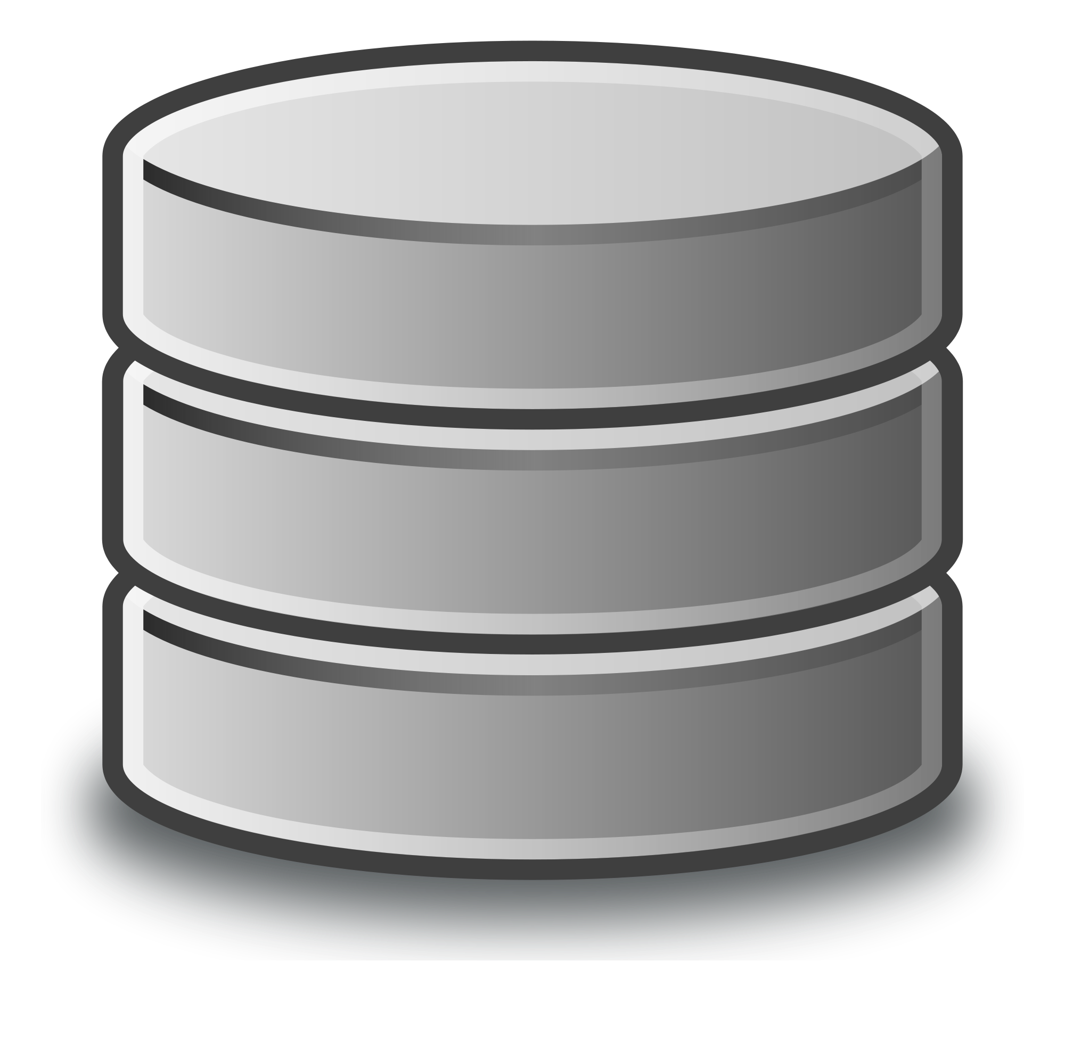


Serverless Architecture
Notes:
Next: Sheet Tweetr

Slide 25
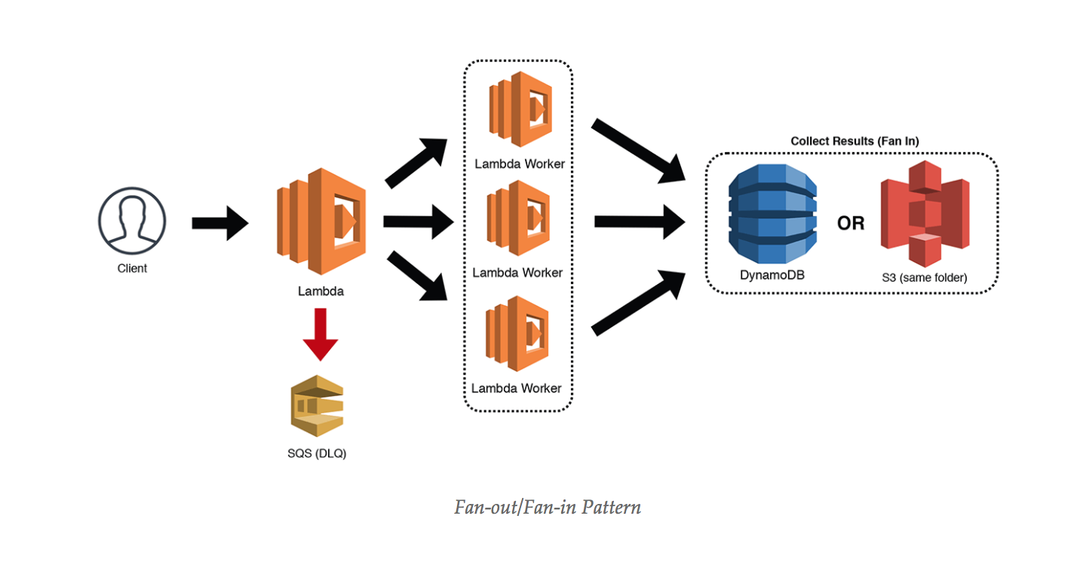
Building Differently
’Serverless Microservice Patterns for AWS’ by Jeremy Daly
https://www.jeremydaly.com/serverless-microservice-patterns-for-aws/
Notes:
TODO: clean up

Slide 26
Use Cases
Scripts triggered by events
External: web hook
Internal: closed ecosystem like Lambda and an s3 event
Your custom code reacts to ‘events’.
Cron job: trigger functions on a schedule.
Web applications
UI driven application calling HTTP endpoints that trigger your code
Notes:
TODO: make prettier

Slide 27
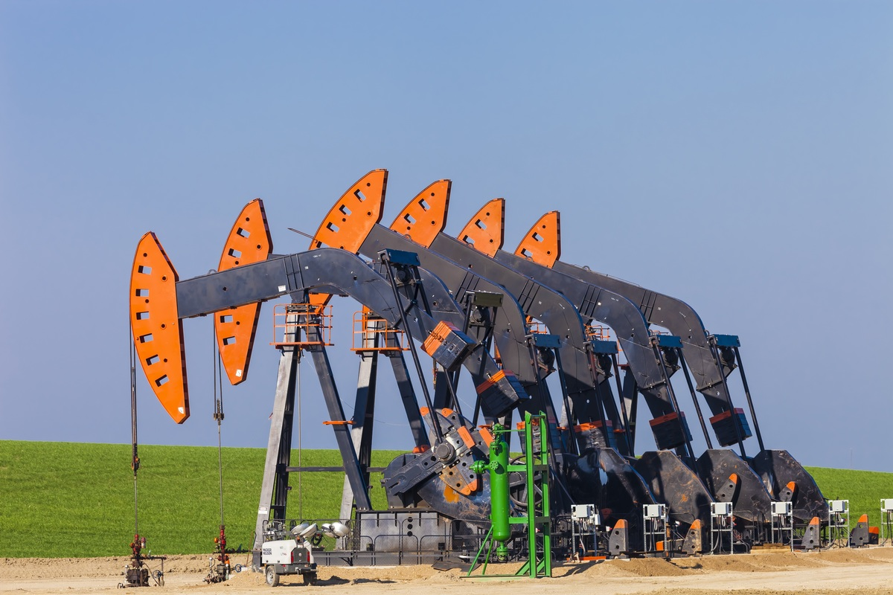
Schneider Electric

Slide 28
Serverless Economy
Notes:
Need error handling section

Slide 29
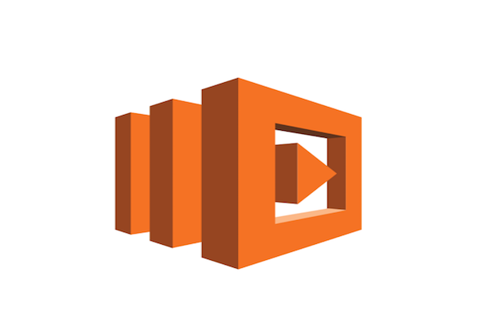
Serverless Web Apps
A web app is more than FaaS…
Typically consists of:
Lambda
API Gateway (HTTP endpoints)
S3 to serve static content
DynamoDB
Many others…
Notes:
TODO: clean up

Slide 30
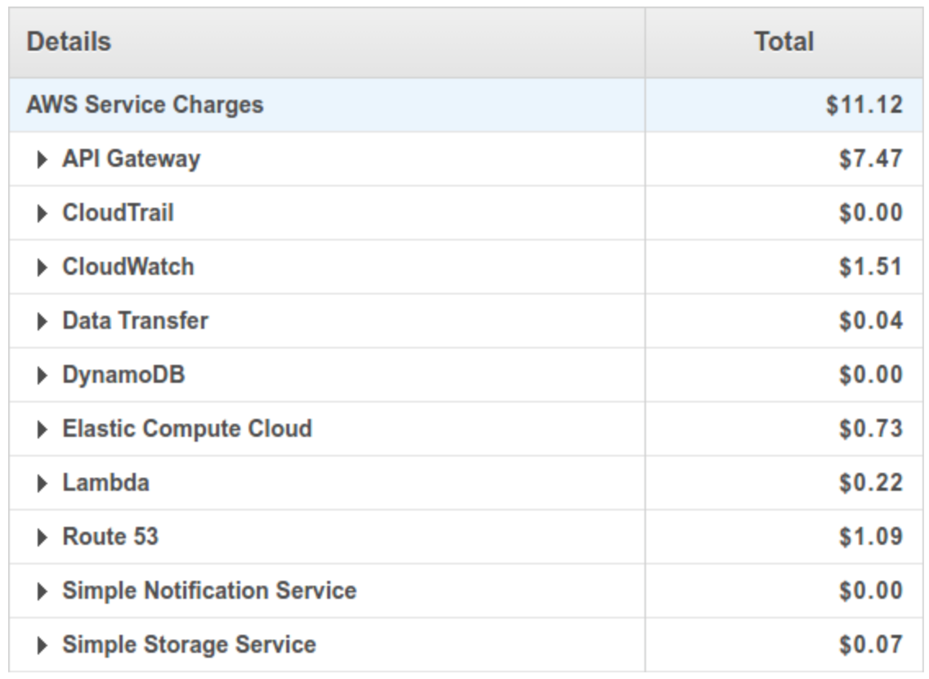
Hidden Costs
TimerCheck.io
Over 2m requests
300k+ seconds of compute

Slide 31
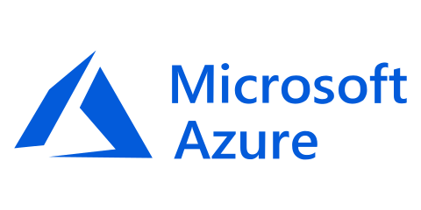
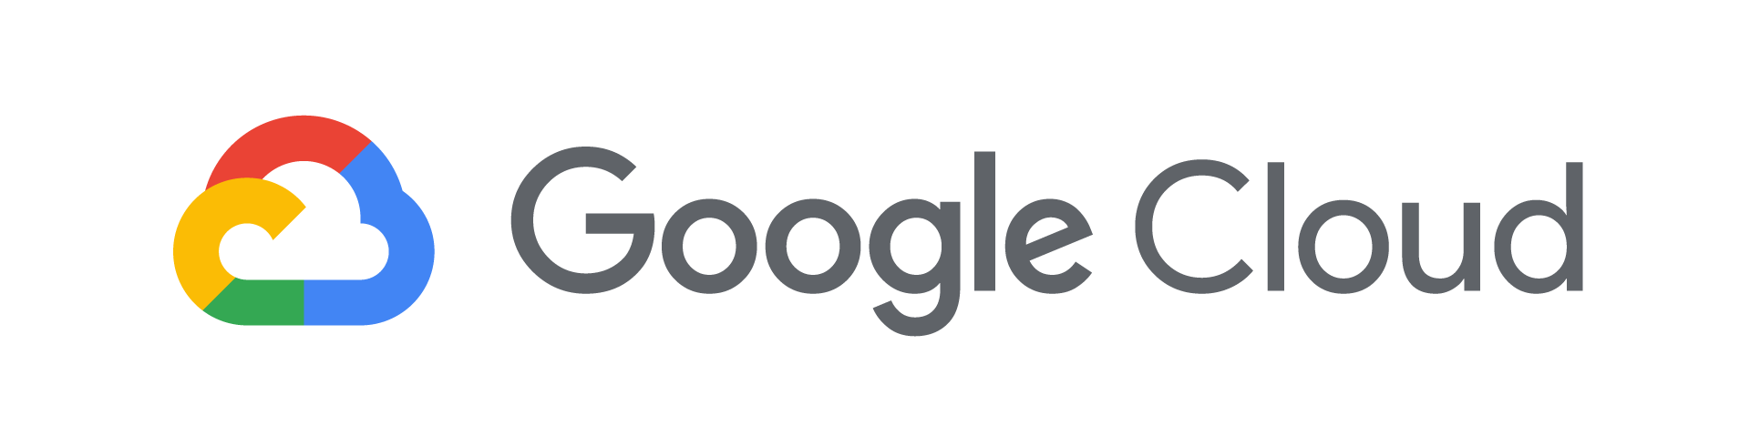
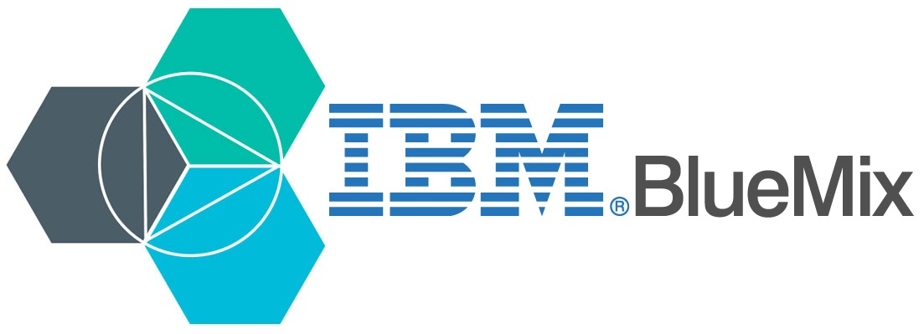
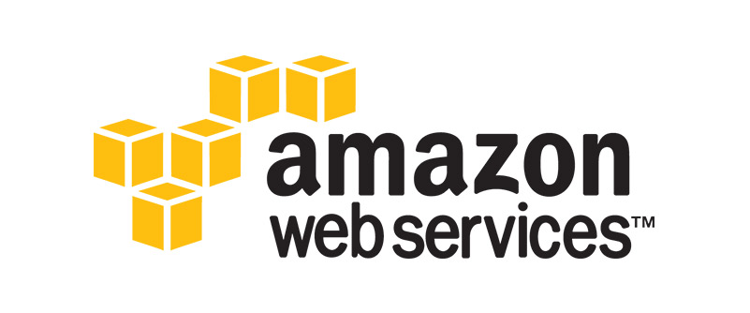
Major Players
Serverless offering: Azure Functions
Launched in March, 2016
Serverless offering: Cloud Functions
Launched in March, 2017
General Availability on July 24, 2018
Serverless offering: Cloud Functions
Launched in Dec, 2017
Available as ‘OpenWhisk’ in Dec, 2016
Serverless offering: Lambda
Launched in Nov, 2014
Most mature ecosystem

Slide 32

Cloud Fight
The Future?
Lambda
Azure Functions
Runs on Linux environment
Functions built as standalone elements
Provisions memory per function
Better scaling for HTTP endpoints
Runs on Windows environment
Multiple functions grouped together as an application
Provisions memory per application
Platform is very user friendly
Robust developer resources
Durable functions
Notes:
AI modules available via API
Computing ‘at the edge’
Serverless all the things (IoT)

Slide 33

Notes:
“you have to play in our sandbox”
Ecosystem of specific tooling. Gives you better integration but your app may depend on a specific feature.
Information gets silo’d in certain tools or services
CloudEvents protocol

Slide 34

What
Open specification about event metadata
Who
Support from IBM, Google, Red Hat, many more
First class support from Microsoft Azure
Why
Interoperable cloud architectures
Distributed data across vendors and clouds
The Serverless and Event-Driven Future
https://www.youtube.com/watch?v=TZPPjAv12KU
Notes:
https://www.youtube.com/watch?v=TZPPjAv12KU

Slide 35
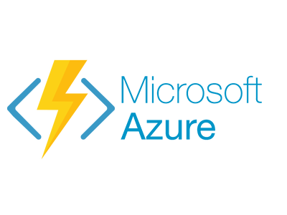



Serverless Providers
AWS ($)
Microsoft ($)
Google ($)
IBM ($)
1,000ms & 128mb & 1m exececutions
L =
0.00 | 0.00 | 0.00 | 0.00
18.55 | 4.40 | 9.76 | 3.83
799.76 | 603.40 | 709.95 | 630.70
22,667.13 | 20,093.40 | 23,321.20 | 21,243.20
1,000ms & 128mb & 5m exececutions
M =
L
M
3,000ms & 256mb & 50m exececutions
H =
H
5,000ms & 512mb & 500m exececutions
!! =
!!
Estimates via serverlesscalc.com from @acloudguru
Notes:
Check pricing practices carefully

Slide 36
Supported Languages
Amazon
Microsoft
Google
IBM
Language
Node.js | Y | Y | Y | Y
Python | Y | Partial | Partial | Y
Java | Y | N | N | Y
C# | Y | Y | N | Y
Go | Y | N | N | Y
F# | N | Y | N | Y
Swift | N | N | N | Y
PHP | N | Partial | N | Y
Notes:
Check pricing practices carefully

Slide 37



Serverless Providers
Other points of consideration?
Your specific needs
Ecosystem
Community
Auth0’s Webtask
Oracle’s Fn Project
Apache’s OpenWhisk
Notes:
Check pricing practices carefully

Slide 38

- Any language!!
- Open source serverless platform
- Can run locally out of a container
- Choose your cloud (or host it yourself)
- Reusable and extensible
- Good introduction to distributed systems
Notes:
Open source serverless platform
Simplicity
Reuasability
Extensibility
Configure different services

Slide 39
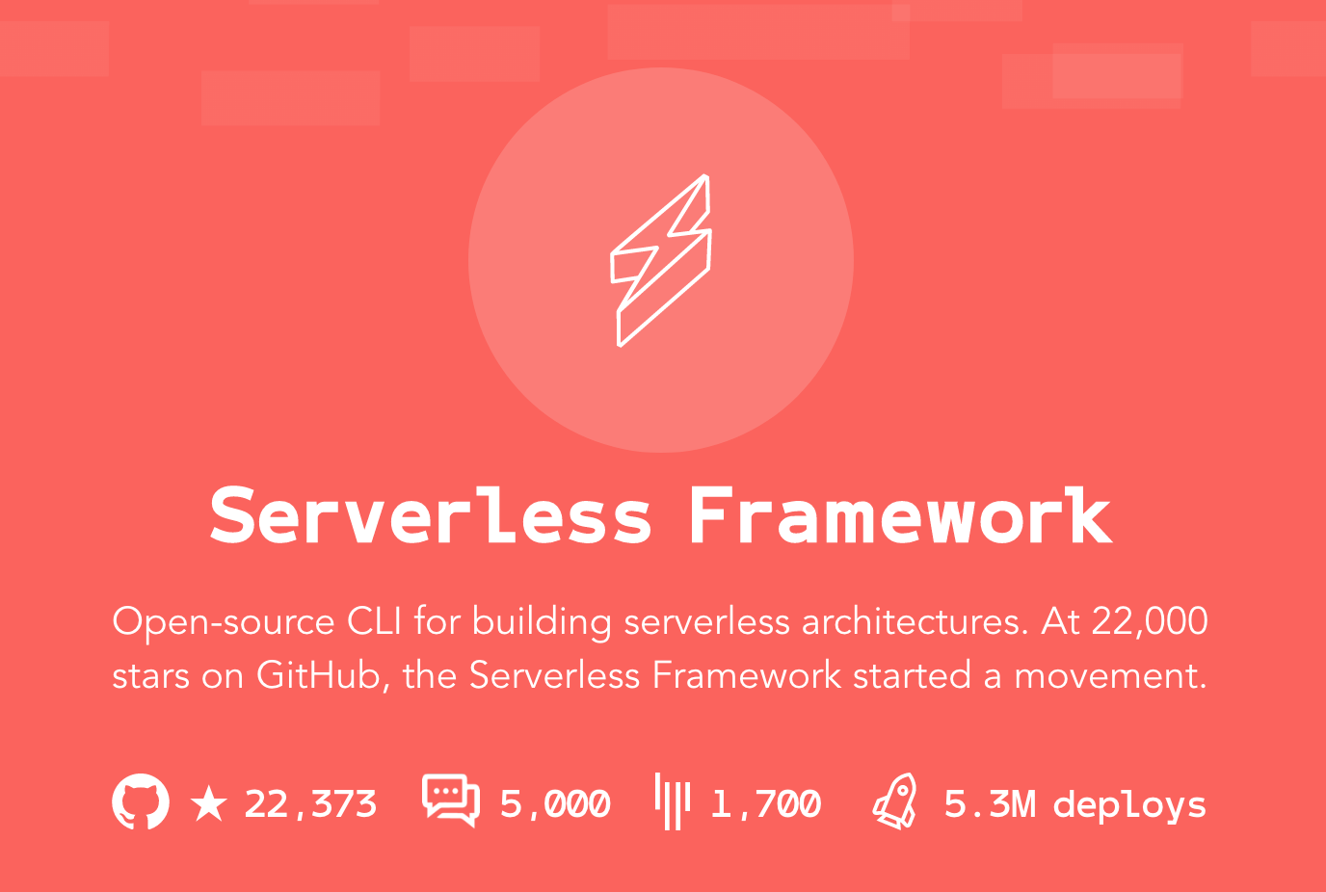
Deploy your serverless code to:
AWS Lambda
Azure Functions
Google Cloud Functions
IBM Cloud Functions
Others…
Notes:
Check pricing practices carefully

Slide 40
Thank you! Questions?
Twitter: @TaylorKrusen

